Slide 1
Convolutional Neural Network Fundamentals
Daniel Acuna
acuna.io

Slide 2
Contents
Main ideas behind CNN
Weight sharing
Large filters
Padding, Striding, Pooling
Multi-dimensional convolution
Upsizing
Hierarhical filter
Example

Slide 3
CONVOLUTIONAL NEURAL NETWORKS
This section introduces a deep learning technique called convolution. Convolution has become the standard method for classifying, manipulating, and generating images.
Convolution is easy to use in deep learning because it can be easily encapsulated in a Convolution layer (also called a convolutional layer).

Slide 4
CONVOLUTIONAL NEURAL NETWORKS
We look at the key ideas behind convolution to see the related techniques we use to make convolution work in practice.
We will how to arrange a series of these operations to create a hierarchy of operations.
This hierarchy can turn a series of simple operations into a powerful tool for processing data or all kinds.

Slide 5
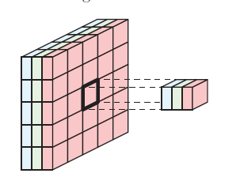
Introducing Convolution
In deep learning, images are 3D tensors, with a height, width, and number of channels, or values per pixel.
A color image stored as RGB has three channels (with values for red, green, and blue) Each pixel in an image is refered to as a feature.
A network in which the convolution layers play a central role is usually called a convolutional neural network, convnet, or CNN. Sometimes people also say CNN network
Deep Learning: A Visual Approach © 2021 by Andrew Glassner

Slide 6
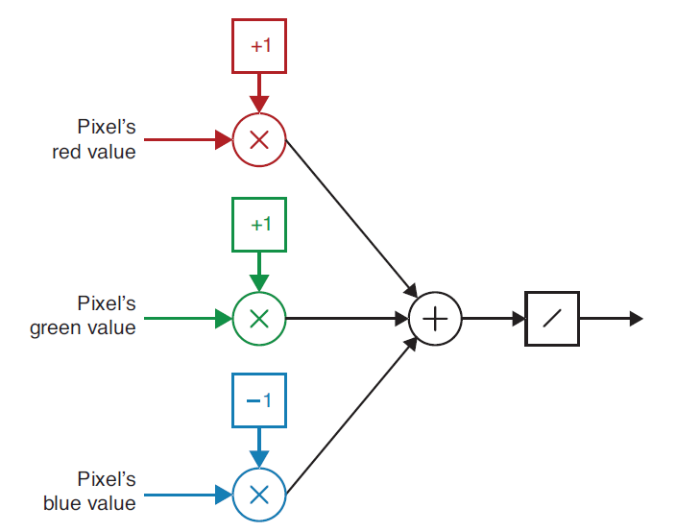
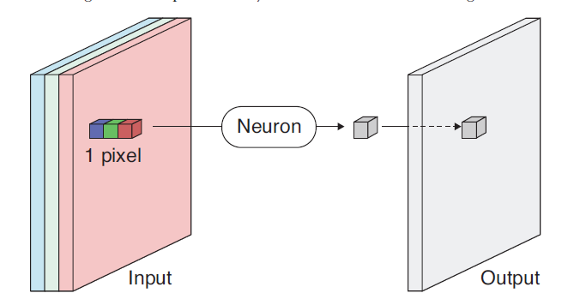
Detecting Colors
For simplicity, let’s assume our RGB values are numbers from 0 to 1. Then a pixel that’s pure yellow has red and green values of 1, and a blue value of 0.
We can apply this operation to every pixel in the input, creating a single output value for every pixel.
We can build a little neuron to detect any color. When call this filtering the input values.
This operation of sweeping the filter over the input corresponds to a mathematical operation called convolution
0
Deep Learning: A Visual Approach © 2021 by Andrew Glassner

Slide 7
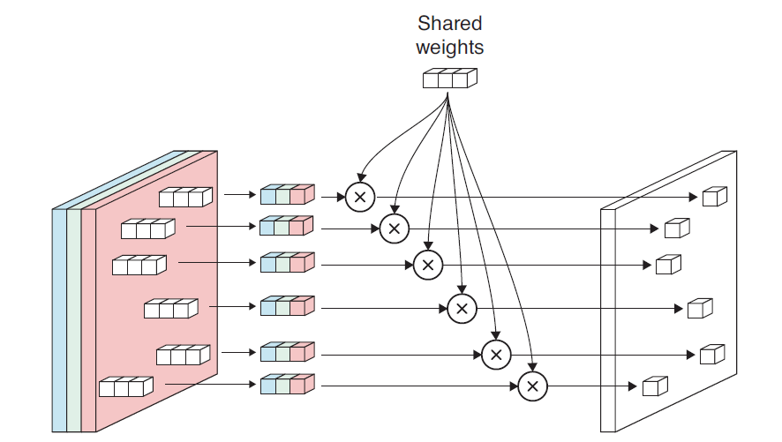
Weight Sharing
We can imagined sweeping our neuron over the input image, performing exactly the same operation at every pixel.
If we want to go faster, we can create a huge grid of identical neurons and apply them to all the pixels simultaneously. This lets us save on memory.
In our yellow detector example, weight sharing also makes it easy to change the color we’re detecting. Rather than change the weights in thousands of neurons (or more), we just change the one set in the shared memory.
Deep Learning: A Visual Approach © 2021 by Andrew Glassner

Slide 8
Convolution Layers
A convolution layer is simply a bunch of filters gathered together. They’re applied independently to the input tensor, and their outputs are combined to create a new output tensor.
When we create a convolution layer in code, we typically tell our library how many filters we want, what their footprint should be, and other optional details like whether we want to use padding and what activation function we want to use—the library takes care of all the rest.
Deep Learning: A Visual Approach © 2021 by Andrew Glassner

Slide 9
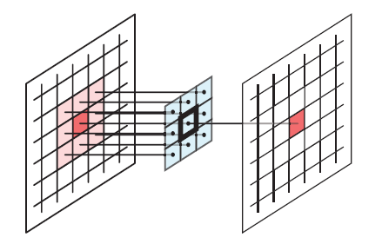
Larger Filters
In many situations, it’s also useful to look at the pixels near the one we’re processing.
Usually we consider a pixel’s eight immediate neighbors. That is, we use the values in a little three by three box that’s centered on the pixel. The shape of the pixels that form a neuron’s input in this scheme is called that neuron’s footprint.
For each input pixel, we imagine centering the three by three grid of weights over each pixel, applying the neuron, and creating a single output value. We say that the pixel we’re centering the filter over is the anchor (or the reference point or zero point).
Deep Learning: A Visual Approach © 2021 by Andrew Glassner

Slide 10
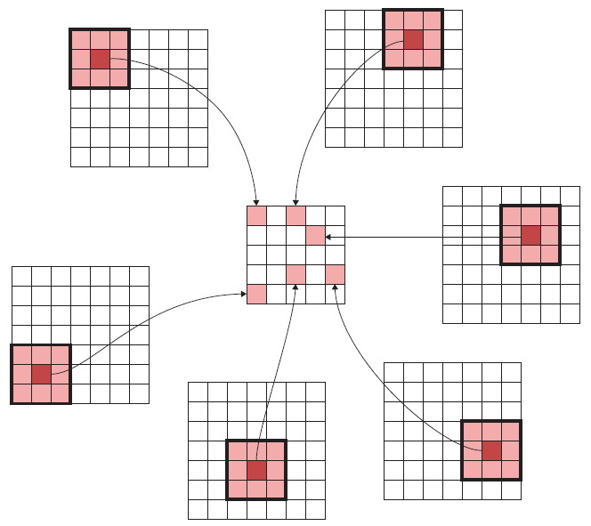
Larger Filters
This diagram shows the result of convolving a seven by seven input with a three by three filter.
When a filter’s footprint is larger than a single pixel, we sometimes emphasize that quality by calling a spatial filter.
We motivated our discussion by looking at spatial filters that can do things like blur an image or detect edges
Deep Learning: A Visual Approach © 2021 by Andrew Glassner

Slide 11
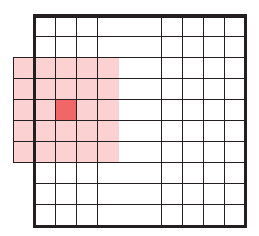
Padding
What happens when a convolution filter is centered over an element in a corner or on an edge of an input tensor.
The footprint of the filter is hanging off the edge of the input. There aren’t any input elements there.
How do we compute an output value for the filter when it’s missing some of its inputs?
Deep Learning: A Visual Approach © 2021 by Andrew Glassner

Slide 12
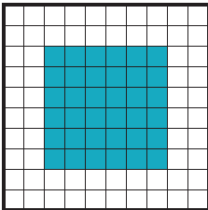
Padding
Padding has us create an output image of the same width and height as the input. We then a border of extra elements around the outside of the input.
We place zeros in all the new elements, called zero-padding.
Most deep learning libraries automatically calculate padding and apply it for us as a default.
We can avoid the “falling off the edge” problem by never letting our filter get that far. With a 5-by 5-filter, we can only center the filter over the elements marked here in blue, reducing our 10-by-10 input to a 6-by-6 output.
Deep Learning: A Visual Approach © 2021 by Andrew Glassner

Slide 13
Convolution layer
Image that the input image is 32 by 32 with 3 channels
The convolution layer can be seen as a volumetric output of the image
Convolution layer

Slide 14
Convolution layer (2)
Each neuron in the convolutional layer has a linear combination of an area of the input
In particular, a slice of the convolution layer
Convolution depth
Convolution layer

Slide 15
Convolution layer: parameter sharing
Convolution depth
Convolutional layers force the weights of the same convolution volume slice to share the same paramaters
Convolution volume layer

Slide 16
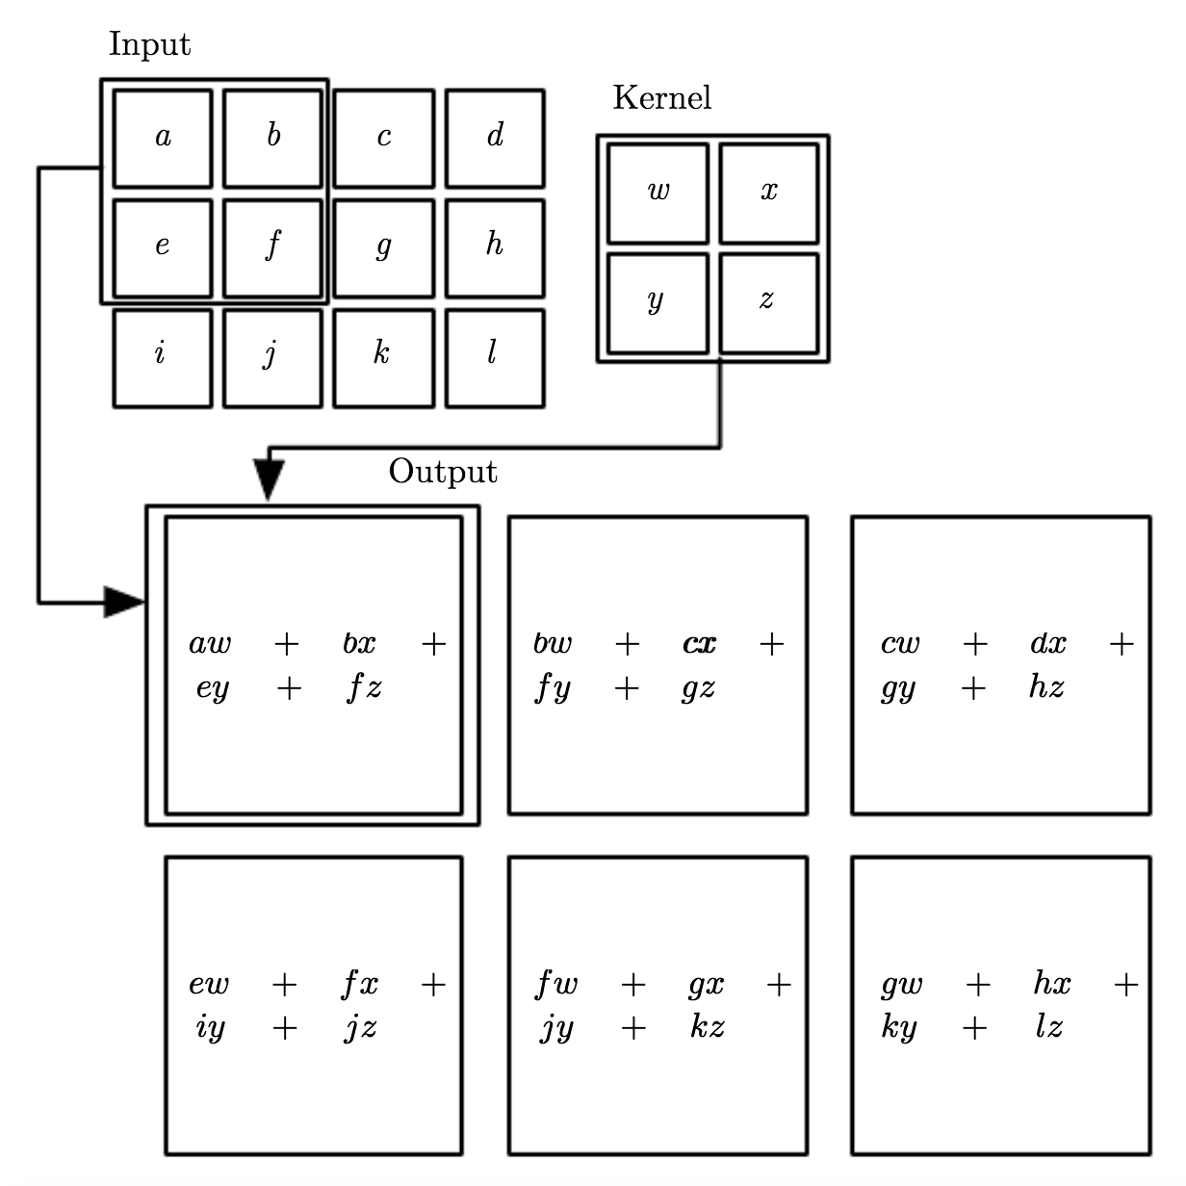
Convolution layer: parameter sharing (2)
This means that we can represent the convolution layer as a set of filters or kernels.
Suppose that we use the following kernel or filter to a set of a pixels (without channels)
What is the value of this kernel applied to the input?

Slide 17
Convolution layer: parameter sharing (3)
Suppose that we use the following kernel or filter to a set of a pixels (without channels)
What if we shift the kernel one position at a time? What is the result?

Slide 18
Convolution layer: parameter sharing (4)
In convolution neural networks, we learn the parameters w, x, y, and z of the kernels
Usually, there is a bias term added

Slide 19
Convolution layer: parameter sharing (5)
In convolution neural networks, we learn the parameters w, x, y, and z of the kernels
Usually, there is a bias term added
A non-linearity is applied to the convolution
One example is ReLU(x) = max(0, x)

Slide 20
Striding
We’ve seen how useful pooling is in a convolutional network. Though pooling layers are common, we can save time by bundling the pooling step right into the convolution process.
This combined operation is much faster than two distinct layers The tensors resulting from the two procedures are different, but experience has shown that the faster, combined operation usually produces results that are just as useful as the slower, sequential operations.
Deep Learning: A Visual Approach © 2021 by Andrew Glassner

Slide 21
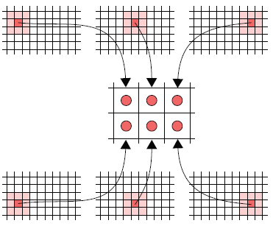
Striding
The filter produces an output, then takes one step right, produces another output
Suppose we move, or stride, more than one pixel to the right, or more than one pixel down, as we sweep our filter.
Then our output will end up being smaller than the input.
We usually use the word stride (and the related striding) only when we use steps greater than one in any dimension.
Deep Learning: A Visual Approach © 2021 by Andrew Glassner

Slide 22
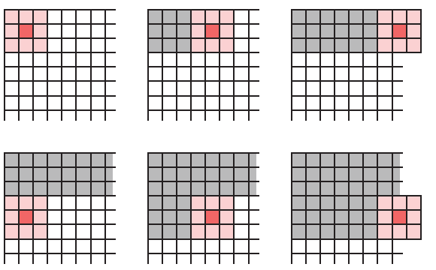
Striding
If we’re trying to save time, we might want to do as little computation as possible.
Then we can use striding to prevent any input element from being used more than once.
For instance, if we’re moving a three by three filter over an image, we might use a stride of three in both directions, so that no pixel gets used more than once,.
Deep Learning: A Visual Approach © 2021 by Andrew Glassner

Slide 23

Convolution Layers
Parameters that define a convolutional layer.
Kernel Size: The kernel size defines the field of view of the convolution. A common choice for 2D is 3 — that is 3x3 pixels.
Stride: The stride defines the step size of the kernel when traversing the image. While its default is usually 1, we can use a stride of 2 for downsampling an image similar to MaxPooling.
Padding: The padding defines how the border of a sample is handled. A (half) padded convolution will keep the spatial output dimensions equal to the input, whereas unpadded convolutions will crop away some of the borders if the kernel is larger than 1.
Input & Output Channels: A convolutional layer takes a certain number of input channels (I) and calculates a specific number of output channels (O). The needed parameters for such a layer can be calculated by I*O*K, where K equals the number of values in the kernel.
https://towardsdatascience.com/types-of-convolutions-in-deep-learning-717013397f4d

Slide 24
Filter
(F=3)
-1 | 1 | -1
Bias = 0
Image
(W=3)
0 | 1 | 0 | 0 | 1 | 0

Slide 25
Filter
(F=3)
-1 | 1 | -1
Bias = 0
Image
(W=6)
0 | 1 | 0 | 0 | 1 | 0
-1
1
-1
0
1
Z = 0 + 0*-1 + 1*1 + 0*-1 = 1

Slide 26
Filter
(F=3)
-1 | 1 | -1
Bias = 0
Image
(W=6)
0 | 1 | 0 | 0 | 1 | 0
-1
1
-1
0
1
Z = 0 + 1*-1 + 0*1 + 0*-1 = -1

Slide 27
Filter
(F=3)
-1 | 1 | -1
Bias = 0
Image
(W=6)
0 | 1 | 0 | 0 | 1 | 0
-1
1
-1
0
1
Z =?

Slide 28
Filter
(F=3)
-1 | 1 | -1
Bias = 0
Image
(W1=6)
0 | 1 | 0 | 0 | 1 | 0
Linear summation
(W2=?)
1 | -1 | -1 | ….

Slide 29
Filter
(F=3)
-1 | 1 | -1
Bias = 0
Image
(W1=6)
0 | 1 | 0 | 0 | 1 | 0
Linear summation
(W2=4)
1 | -1 | -1 | 1

Slide 30
Filter
(F=3)
-1 | 1 | -1
Bias = 0
Image
(W1=6)
0 | 1 | 0 | 0 | 1 | 0
Linear summation
(W2=4)
1 | -1 | -1 | 1
ReLU
(W2=4)
? | ? | ? | ?

Slide 31
Filter
(F=3)
-1 | 1 | -1
Bias = 0
Padding
(P=1)
Image
(W=6)
0 | 0 | 1 | 0 | 0 | 1 | 0 | 0
-1
1
-1
0
1
Size of output?
Z = -1

Slide 32
Filter
(F=3)
-1 | 1 | -1
Bias = 0
Padding
(P=1)
Stride
(S=2)
Image
(W=6)
0 | 0 | 1 | 0 | 0 | 1 | 0 | 0
Size of output?
Move S spaces

Slide 33
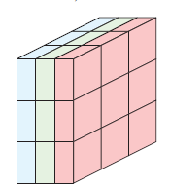
Multidimensional Convolution
We know that most color images have three channels, representing the red, green, and blue components of each pixel.
To process an input with multiple channels, our filters need to have an identical number of channels.
For an RGB image, a filter needs three channels. So, a filter with a footprint of three by three needs to have three channels, for a total of 27
Deep Learning: A Visual Approach © 2021 by Andrew Glassner

Slide 34
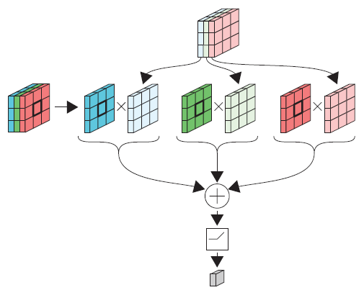
Multidimensional Convolution
Our input has three channels, so our filter has three channels as well.
This idea generalizes to any number of channels.
Rule #1: every filter must have the same number of channels as the tensor it’s filtering.
Convolving an RGB image with a three by three by three kernel.
Deep Learning: A Visual Approach © 2021 by Andrew Glassner

Slide 35
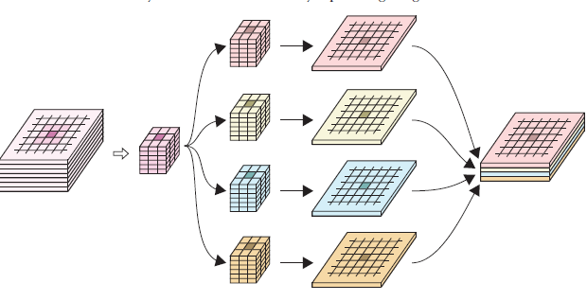
Multidimensional Convolution
Generally speaking, our filters can have any footprint.
The input tensor at the far left has seven channels.
We’re applying four different filters, each with a three by three footprint, so each filter is a tensor of size three by three by seven.
Rule #2 - A convolution layer’s output tensor will have as many channels as there are filters in the layer.
Deep Learning: A Visual Approach © 2021 by Andrew Glassner

Slide 36
Convolution layer: strides and padding
In practice, the filter can be applied with different strides and padding

Slide 37
Convolution layer: strides and padding (2)
In practice, the filter can be applied with different strides and padding

Slide 38
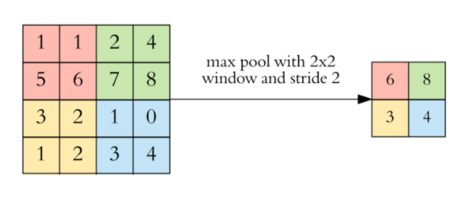
Pooling
The addition of a pooling layer after the convolutional layer is a common pattern used for ordering layers within a convolutional neural network that may be repeated one or more times in a given model.
The pooling layer operates upon each feature map separately to create a new set of the same number of pooled feature maps.
https://towardsdatascience.com/applied-deep-learning-part-4-convolutional-neural-networks-584bc134c1e2

Slide 39
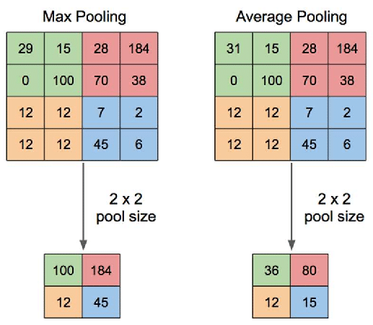
Pooling
Two common functions used in the pooling operation are:
Average Pooling: Calculate the average value for each patch on the feature map.
Maximum Pooling (or Max Pooling): Calculate the maximum value for each patch of the feature map.
https://www.researchgate.net/figure/Illustration-of-Max-Pooling-and-Average-Pooling-Figure-2-above-shows-an-example-of-max_fig2_333593451
https://machinelearningmastery.com/pooling-layers-for-convolutional-neural-networks/

Slide 40
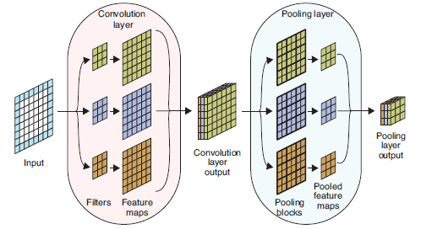
Pooling
Pooling is a powerful operation that frees filters from requiring their inputs to be in precisely the right size
Pooling also has the bonus benefit of reducing the size of the tensors flowing through our network, which reduces both memory needs and execution
time.
Deep Learning: A Visual Approach © 2021 by Andrew Glassner

Slide 41
Pooling (2)

Slide 42
Upsizing

Slide 43
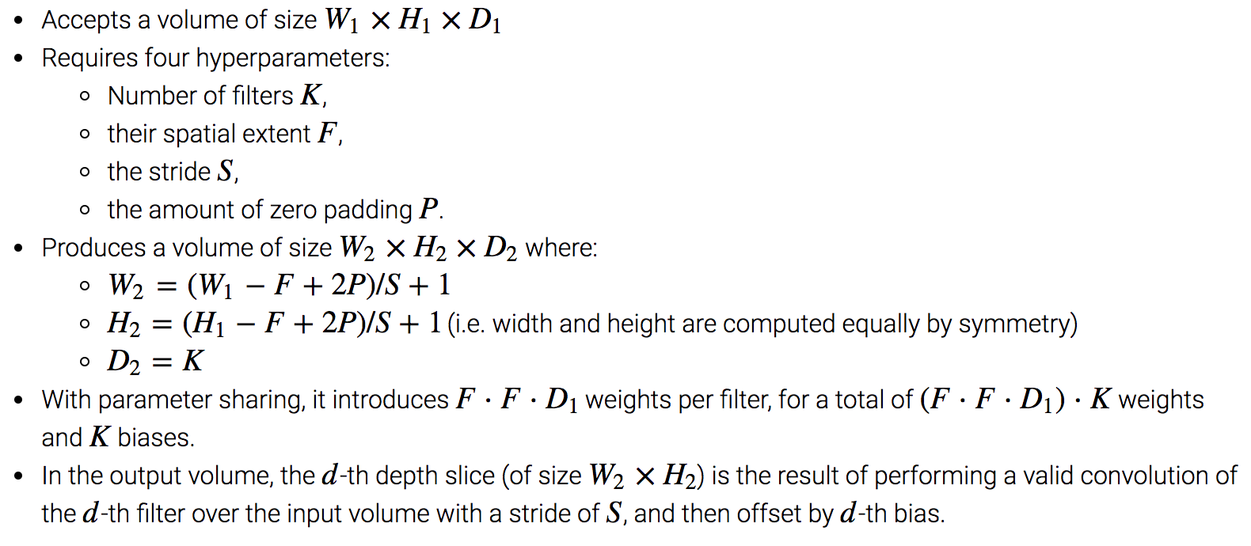
Convolution layer: sizes
Credit: http://cs231n.github.io/convolutional-networks/

Slide 44
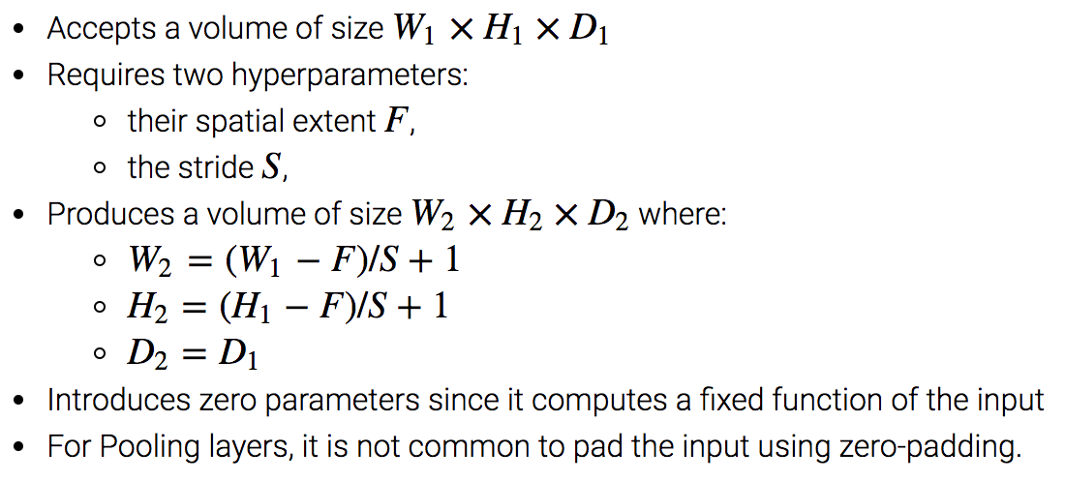
Pooling layer: sizes
Typical parameters for pooling are: F = 3, S = 2 and F = 2, S = 2

Slide 45
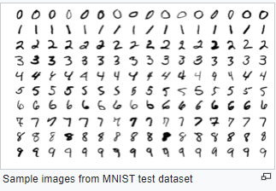
Building a Simple MNIST Convnet
Setup
Prepare the data
Build the model
Set Notebook to GPU
Train the model
Evaluate the trained model

Slide 46
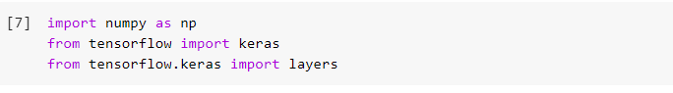
Building a Simple MNIST Convnet
Setup

Slide 47
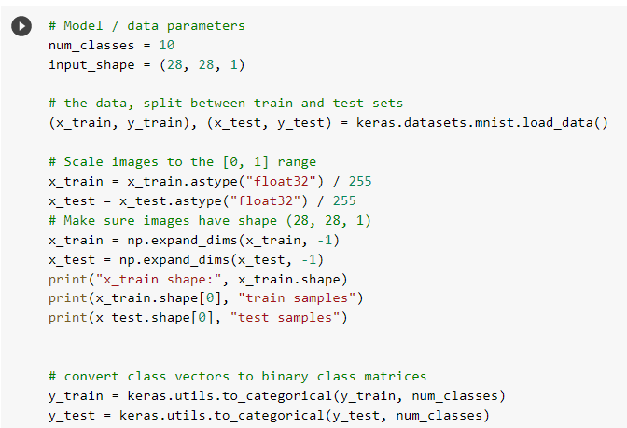
Building a Simple MNIST Convnet
Prepare the data

Slide 48
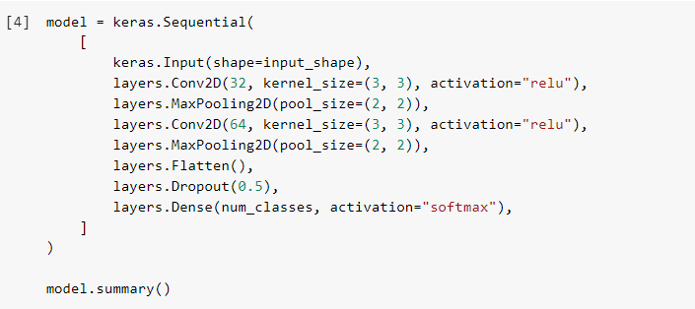
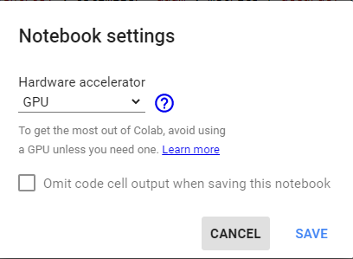
Building a Simple MNIST Convnet
Build the model
Set Notebook to GPU
Check the size of layers

Slide 49
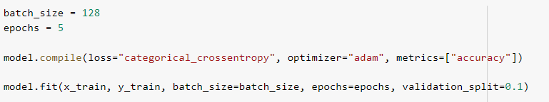
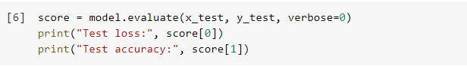
Building a Simple MNIST Convnet
Train the model
Evaluate the trained model

Slide 50

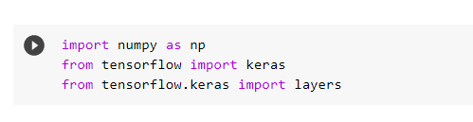
Building a Simple MNIST Convnet
To Get Started
Go to this URL
https://keras.io/examples/vision/mnist_convnet/
Click Google Colab
Run Each Section in Sequence
Hover over section
Press Arrow

Slide 51
Compare against a multi-layer perceptron
Use layers.Dense to create flatten layers
Pay attention to the input size, what do you need to do before feeding it into a MLP?
What is the performance of MLP?

Slide 52
Filter hierarchy

Slide 53
Example for detecting face mask

Slide 54
Example for detecting a face mask (2)

Slide 55
Example for detecting face mask (3)

Slide 56
Detecting impect features (multiple filters)

Slide 57
Creating a hierarchy of filters

Slide 58
Multi-layer CNN

Slide 59
Apply layers one by one

Slide 60
Apply layers one by one

Slide 61
Apply layers one by one (3)

Slide 62
Apply layers one by one (4)

Slide 63
Apply layers one by one (5)

Slide 64
Online demo
https://cs.stanford.edu/people/karpathy/convnetjs/demo/mnist.html

Slide 65
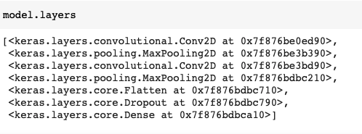
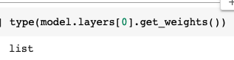
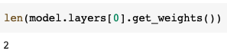
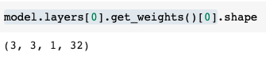
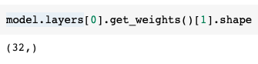
Let's visualize filters
We can get the weights of the layers
One array are the biases
32 filters
32 biases

Slide 66
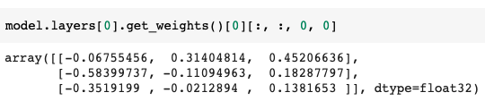
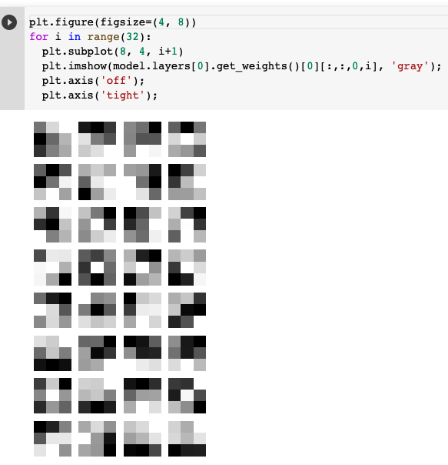
Let's visualize filters (2)
We can get the weights of the layers

